Slide 1


Intro to Data Analytics and AI Camp
Artificial Intelligence and MATLAB for Sports and Music Analytics

Slide 2
What is Artificial Intelligence
Artificial Intelligence is the way we program a computer to do something a human would normally do.
There are lots of ways to program a computer to do this, and some computers can “learn” from the data they are trained on.
Artificial intelligence requires a lot of data, much of it from multiple sources
Humans have to work with computers to make them intelligent and able to do they task we have asked it to do.

Slide 3
Music Analytics
Finding new musicians has changed in the last 20 years
People used to go to clubs all the time to find new talent
People had to stream endless You Tube videos
People had to listen to Apple Play or streams from Spotify
People had to look at endless webpages and Twitter (now X) feeds
Now you can grab data from all these sources to find new talent

Slide 4
What if you had to find the next…
Bad Bunny?
Beyonce?
Taylor Swift?
Lil Crix?

Slide 5
Sports Analytics
Finding new talent in sports has changed in the past 20 years
Talent agents had to go to games all over the world to spot talent
Finding talent is small towns or small countries was difficult
Analyzing player data over time had to be done in spreadsheets or by hand
Clubs could not identify talent fast enough to get them in development programs
Players were limited in choices

Slide 6
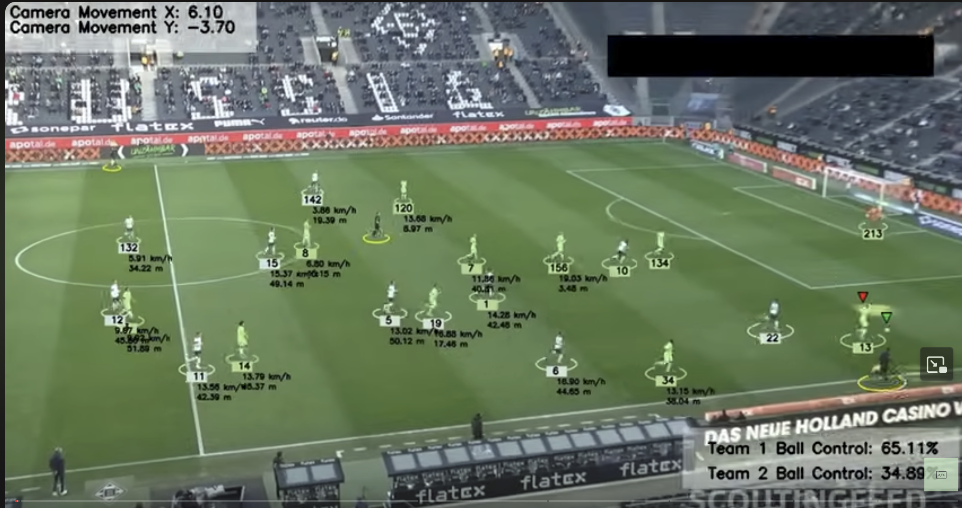
Sports analytics in real time

Slide 7
Transformation through Data Analytics
Data is everywhere and occurs in many forms – music(sound), Images, video, statistics, lyrics….
Computers can analyze this data to show allow you to analyze the potential of a musical artist or sports player
Humans have to help the computer understand what data is important in the decision making and train the computer to make good decisions.
Humans have to understand these decisions.

Slide 8

Congratulations! You have a job!
You have just been hired as a Talent Agent for a sports or Music company
In this course you will learn everything you need to know to find new talent.
Your final project is to create a program that can analyze and predict if a new talent will be successful for your company.
You will work in a team to achieve your goals for your project.

